Slide 1
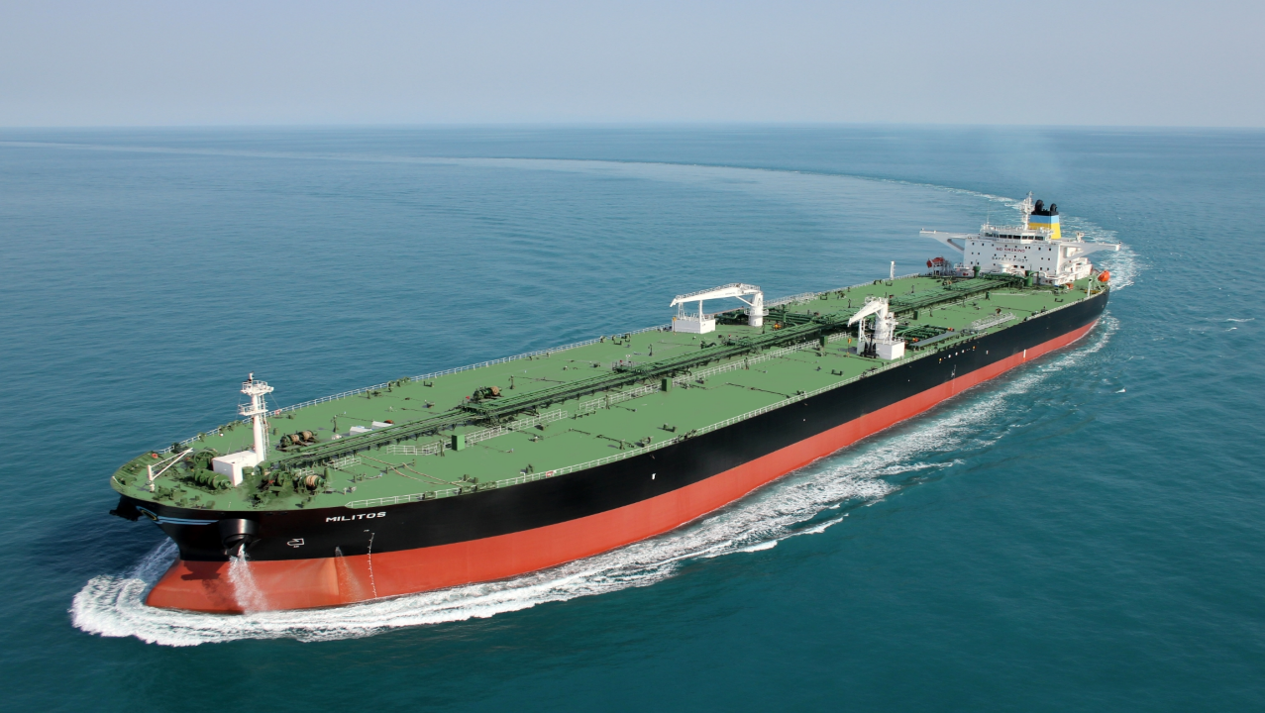


Slide 2

A message from our CEO
2020 was still very young when it sprang on us a very nasty surprise, CORONAVIRUS
All of sudden plans had to be scrapped, schedules were upended and we had to learn, very quickly, to live with an invisible threat under unprecedented circumstances.
But with the whole world locking down, it was absolutely vital to keep goods and commodities moving, and this meant that you, the mariners, had to be once more at the forefront.
Despite the anxiety about your loved ones health, you had to ensure that business continued as usual.
Despite being severely affected and literally stuck on board because of the lockdowns in ports, closure of airports, the cancellation of flights.
At the same time you had to keep your focus on maintaining the safety, quality and environmental standards onboard at the high levels, which you yourselves had established.
You did it and continue doing it in an outstanding manner and we wholeheartedly thank you for that.
Dimitrios Korkodilos
Chief Executive Officer
Andriaki Shipping Co. Ltd.

Slide 3
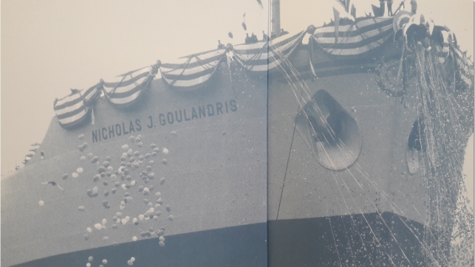
Our Vision
Heading towards new business frontiers and innovations while staying true to our family tradition for excellence, continuous improvement and dedication to environmental sustainability and respect for our people.

Slide 4
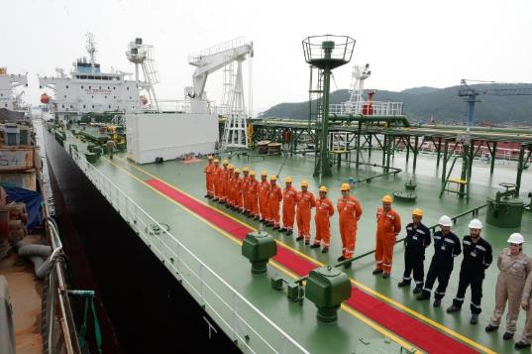
Our Mission
We are a discerning team dedicated to a quality of marine transport that inspires trust and loyalty in our partners in business and makes our people proud.
We effectively adapt to challenges with ethos and commitment to safety and the protection of the environment

Slide 5
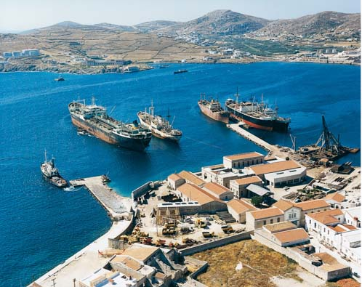
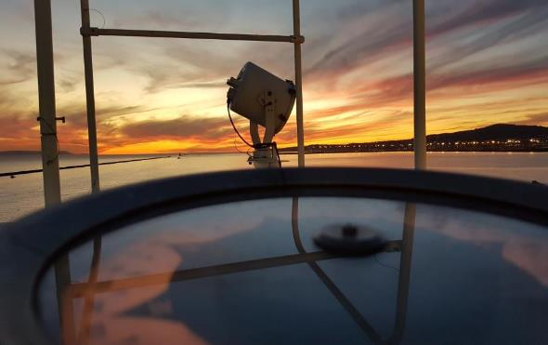
Our Values
  Honesty
          Integrity
    Respect
              Collaboration
  Diligence
          Preferred Partners

Slide 6

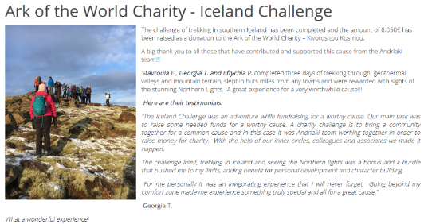
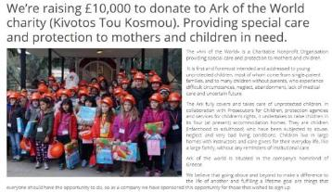
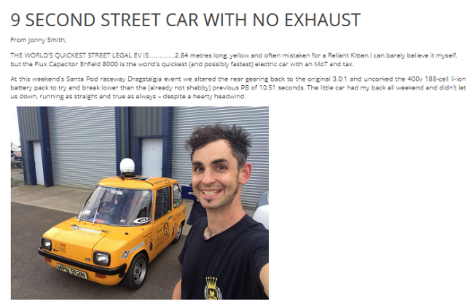
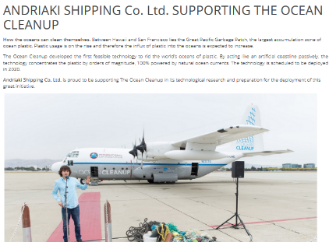
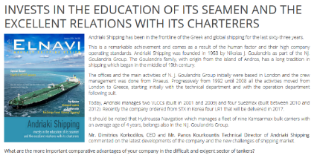
Our Culture

Slide 7
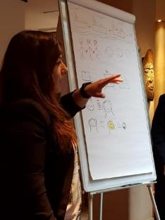
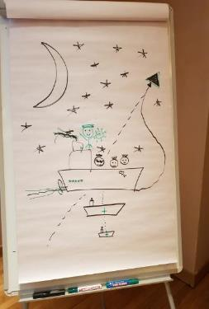
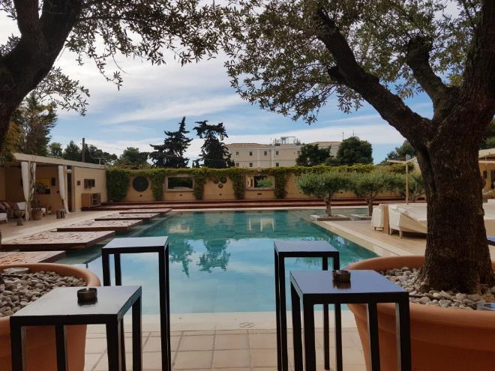
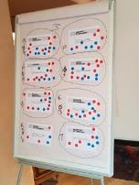
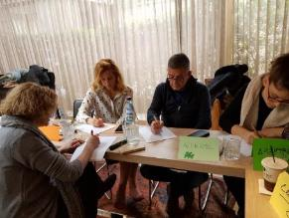
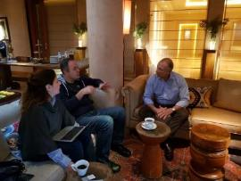
2019 Preview
Our Workshop @ The Margi

Slide 8
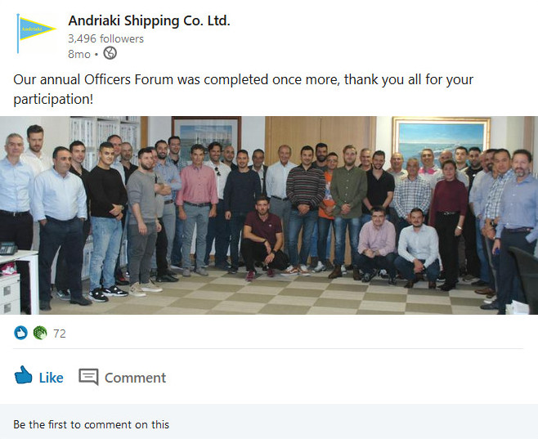
2019 Preview
Our 2019,Annual Officers Forum

Slide 9
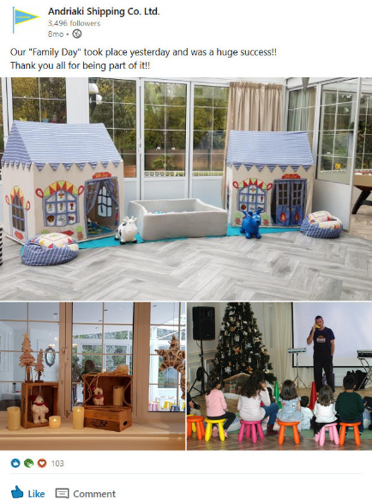
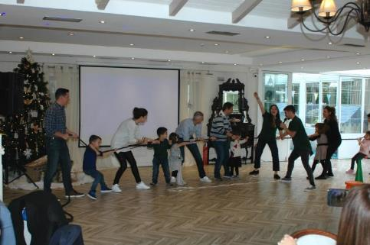
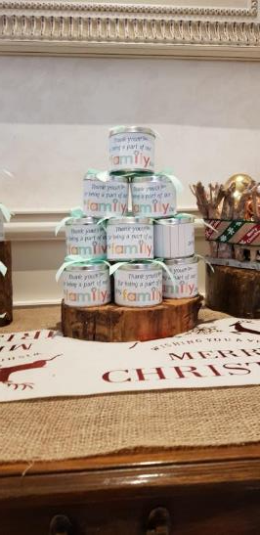
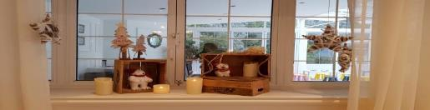
2019 Preview
Our 1st Family Day
Sunday, November 24^{th,} 2019 @ Ktima Diamond, Nea Kifisia

Slide 10
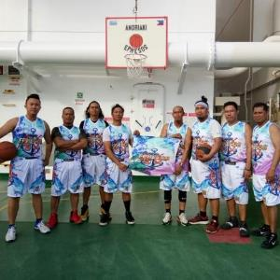

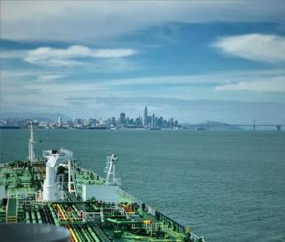
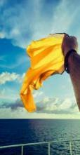
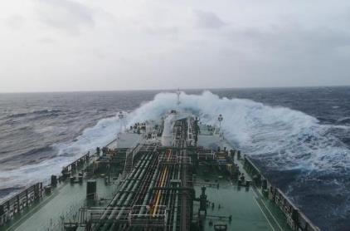
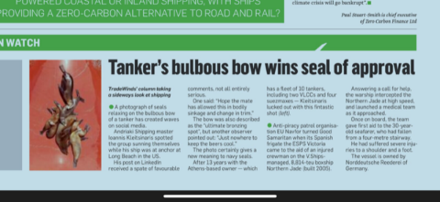
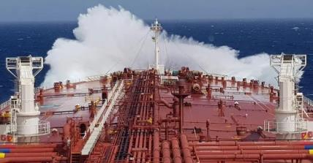
Our News
Our 1st Photo Competition started in November 2019 for Crew & Office Staff

Slide 11
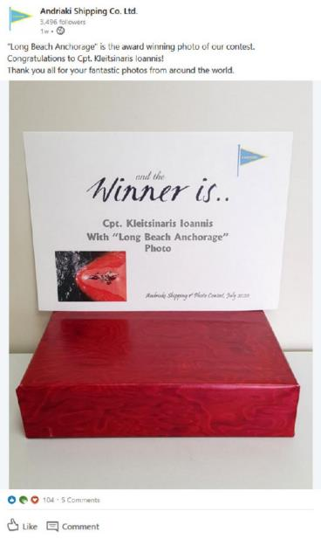
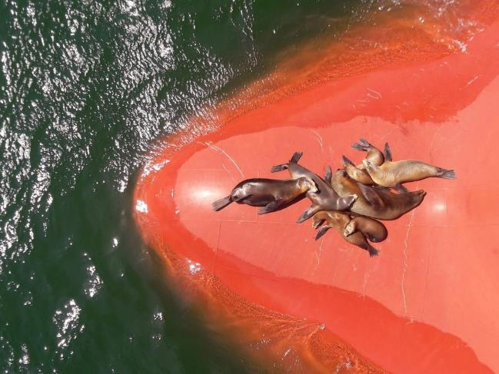
Our News
Our 1st Photo Competition Winner

Slide 12
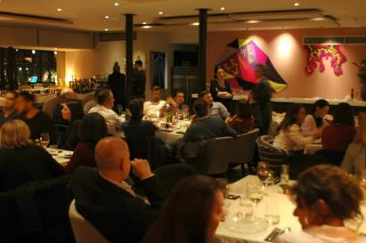

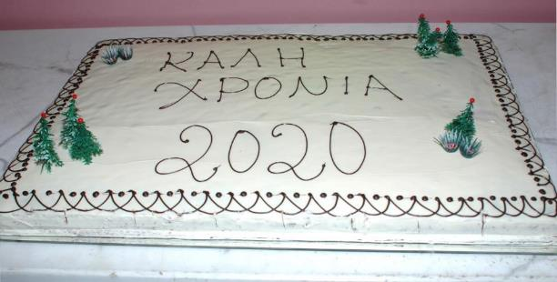
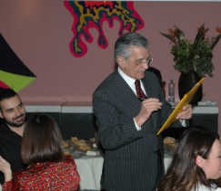
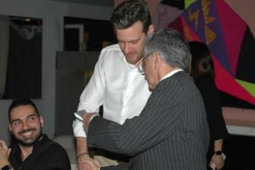
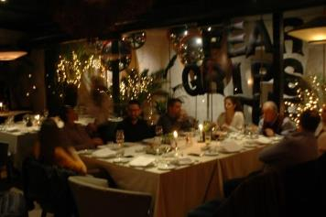
Our News
Our Annual Pita Cutting Event took place @ Twenty One Restaurant

Slide 13
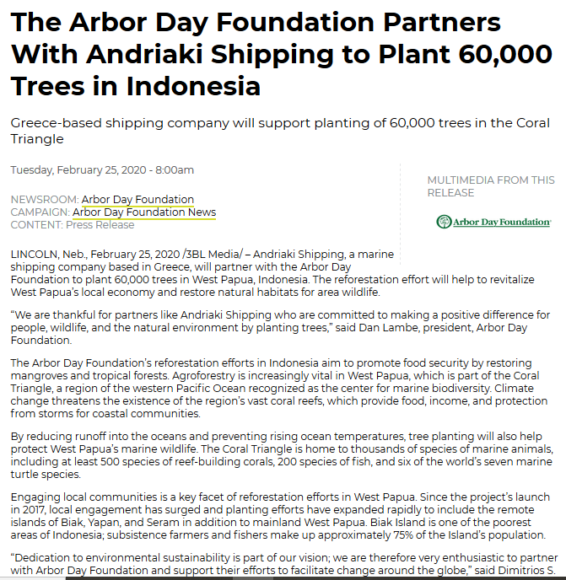

Our News
Andriaki partners with The Arbor Day foundation to plant 60.000 trees in Indonesia

Slide 14
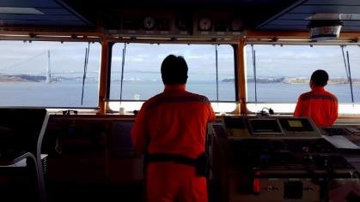

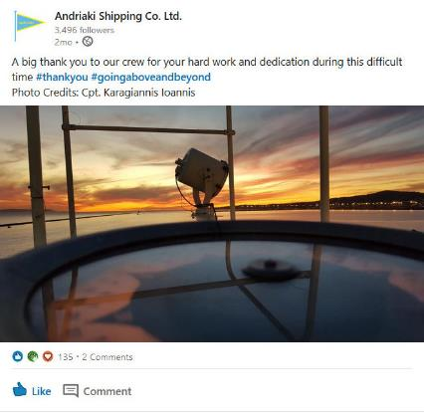
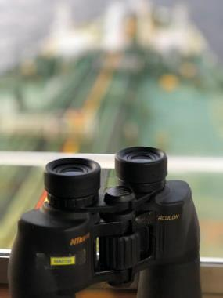
Our News
Sending a BIG
for your hard work and dedication during this difficult time

Slide 15
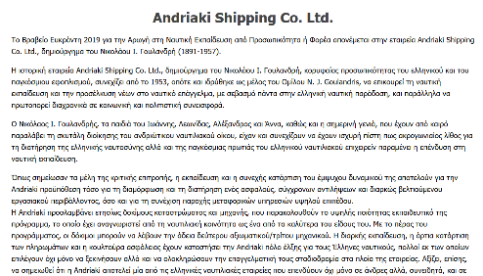
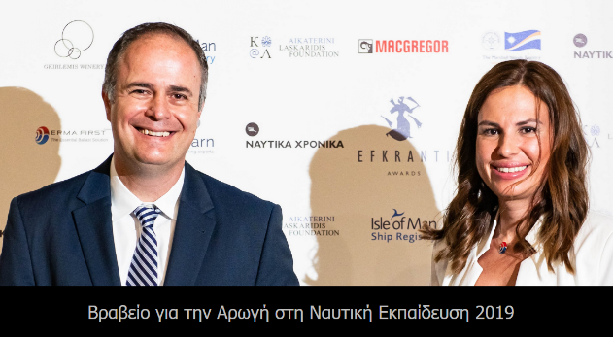

Our News
Andriaki Shipping was honored with the Efkranti Award for its contribution to Naval Education

Slide 16
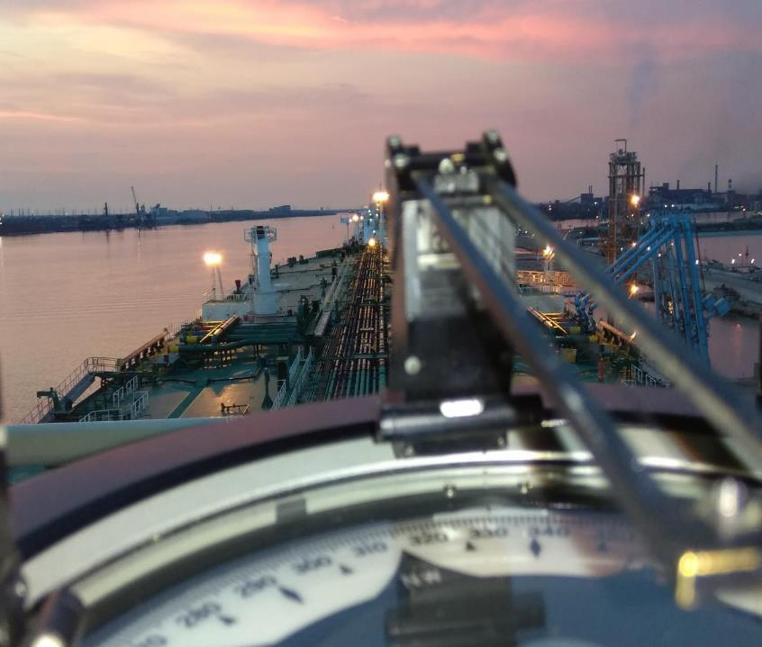
Thank you

